Slide 1
Iran University of Science and Technology
Faculty of advanced Technologies
Sensors and Actuators Project Final Presentation
Title:
Simulation of MEMS Inertial Earth Sensor Dynamic for Measuring Gravity Gradient Torque in Low Earth Orbit
Siavash Sabzy
Dr. M. Farajollahi
Feb. 2019

Slide 2
Table of Contents
Introduction
Gravity Gradient Torque
Attitude Determination by Gravity Gradient Torque
MEMS GGES
Spacecraft and Sensor Dynamic
Simulation
Conclusion

Slide 3
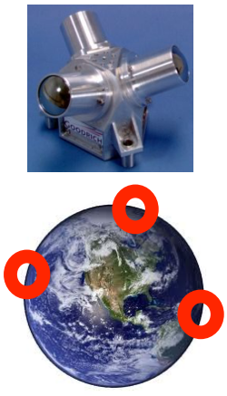
Introduction
Current Earth Sensors and sensors based on astronomical references have a limited Field of View
– Multiple units required all over satellite for complete coverage
– Limits ability to reacquire attitude on a tumbling satellite
– Prone to saturation due to presence of sun / moon in field of view
To overcome limitations of existing sensors, a new sensing scheme needed
– Use Earths gravity field as a reference

Slide 4
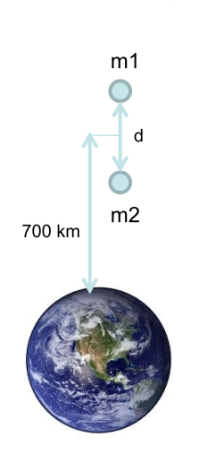
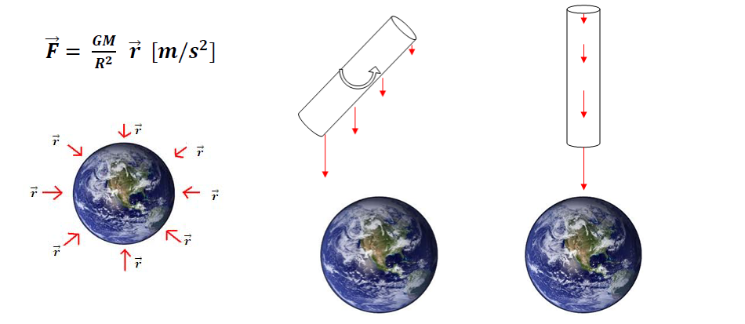
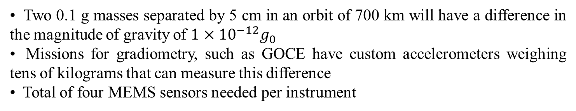
Gravity Gradient Torque
• Two 0.1 g masses separated by 5 cm in an orbit of 700 km will have a difference in the magnitude of gravity of $1×{10}^{−12}g_{0}$
• Missions for gradiometry, such as GOCE have custom accelerometers weighing tens of kilograms that can measure this difference
• Total of four MEMS sensors needed per instrument
GG: Gravity Gradient
Used to passively stabilize the attitude of satellites designed with an elongated shape [GEOSAT]
• Use this phenomenon to develop an Earth Sensor with a mass of 1 kg and volume of 1 dm^3 for LEO
• Measure pitch and roll angles with an accuracy of +/- 2 degrees @ update rate 1-10 Hz

Slide 5
Goals and Challenges
Goals
For the attitude determination instrument with MEMS ES
– Single unit with 4pi steradian coverage
– +/- 2° accuracy
– Volume < 1 dm^3
– Mass < 1 kg
– Power < 5 W
– Update rate > 1 Hz
Challenges
To achieve sufficient Signal to Noise Ratio to measure pitch and roll with the required accuracy in LEO:
– “Big” proof mass desired (0.1 g)
– Soft spring needed
– Develop a reliable fabrication process and packaging so that sensor can be fabricated and tested in 1g
– Test setup to reproduce the expected displacement in microgravity in 1g
– Sensitive yet robust displacement measurement scheme capable of measuring sub-nm displacements

Slide 6
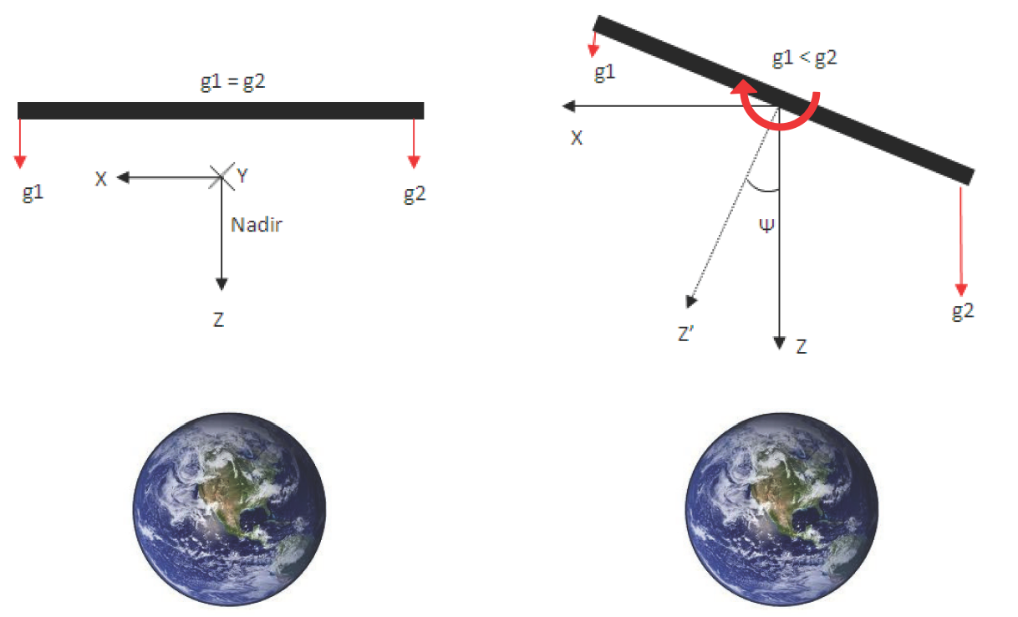
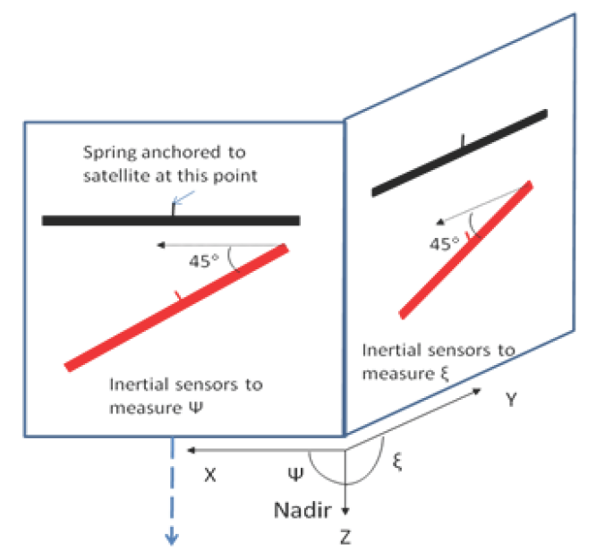
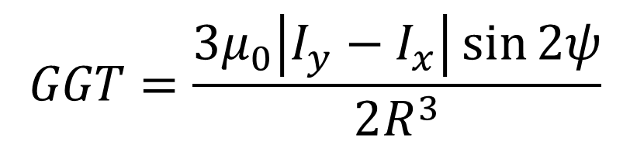
Attitude Determination by Gravity Gradient Torque
$$GGT=\frac{3μ_{0}\left|I_{y}−I_{x}\right|\sin{2ψ}}{2R^{3}}$$

Slide 7
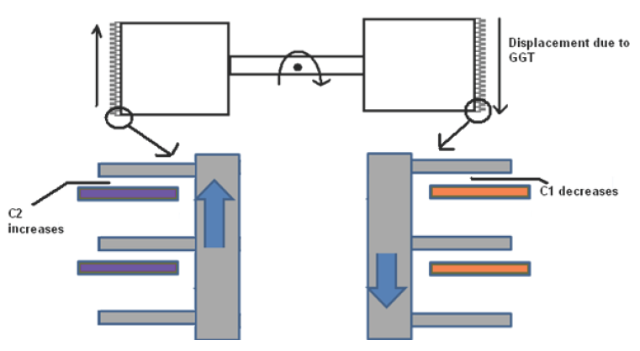
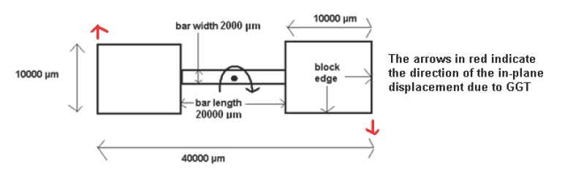
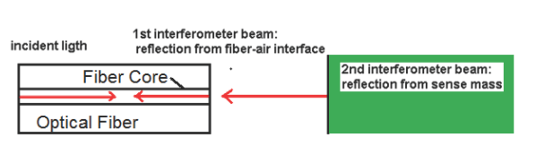
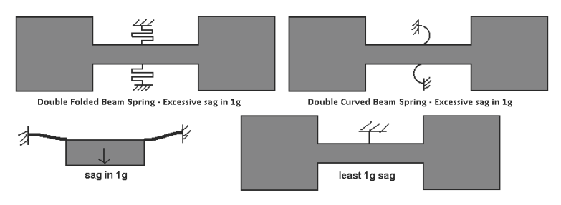
MEMS GGES
Proof Mass Properties
Proof Mass Total Length | 4 cm
Proof Mass Bar Length | 2 cm
Proof Mass Bar Breadth | 0.2 cm
Proof Mass Breadth at extremities | 1 cm
Proof Mass Thickness | 600 μm
Proof Mass Maximum Moment of Inertia | 6.9 x 10^-8 N.m^2
Proof Mass Weight | 0.33 g
Spring Properties
Spring Length | 1000 μm
Spring Width | 15 μm
Spring Depth | 100 μm
Sensor resonant frequency | 1.36 Hz
Hard Stops
Lateral Clearance | 30 μm
Vertical clearance | <4 μm
Optical Displacement Sensing
Fiber tip distance from Proof Mass | 35 μm
Laser Wavelength | 635 nm

Slide 8

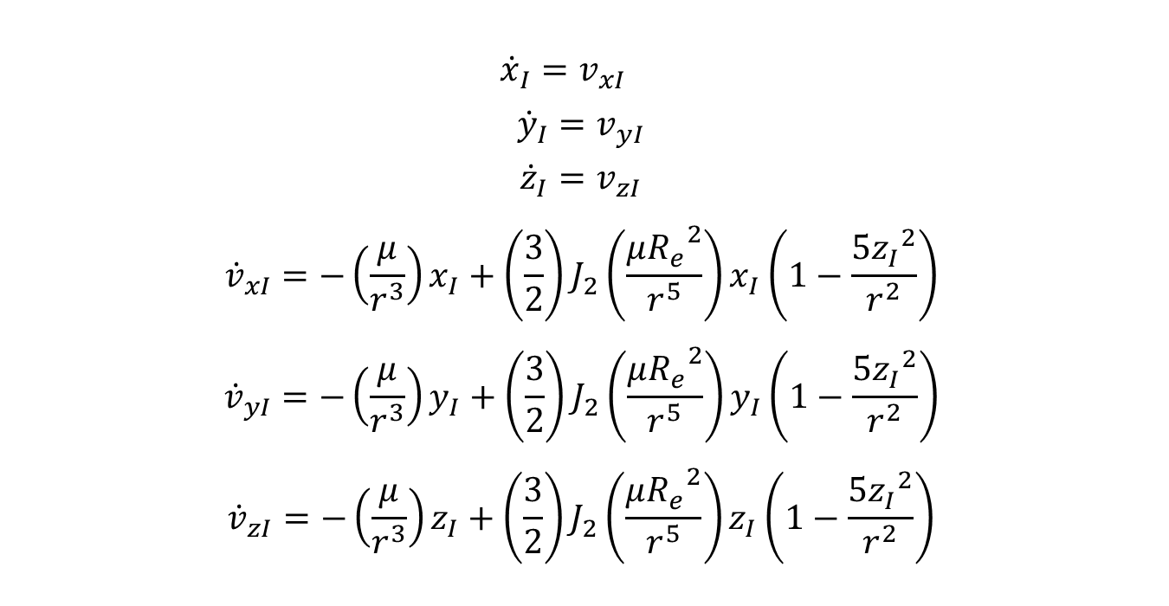
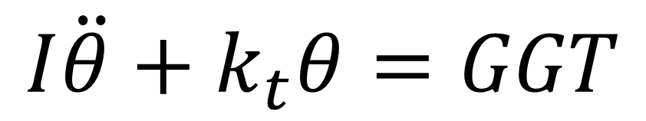
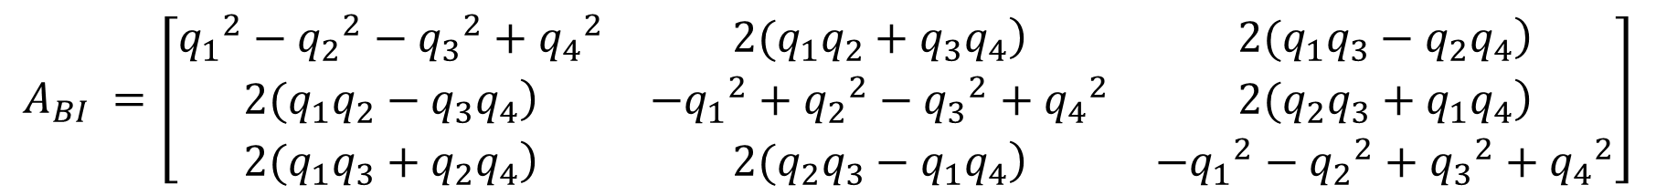
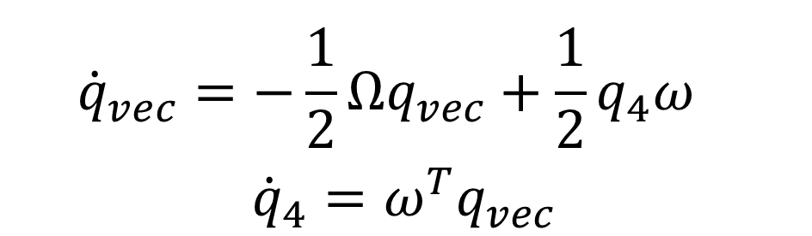
Spacecraft and Sensor Dynamic
 | $${\dot{x}}_{I}=v_{xI}$$ $${\dot{y}}_{I}=v_{yI}$$ $${\dot{z}}_{I}=v_{zI}$$ $${\dot{v}}_{xI}=−\left(\frac{μ}{r^{3}}\right)x_{I}+\left(\frac{3}{2}\right)J_{2}\left(\frac{μ{R_{e}}^{2}}{r^{5}}\right)x_{I}\left(1−\frac{5{z_{I}}^{2}}{r^{2}}\right)$$ $${\dot{v}}_{yI}=−\left(\frac{μ}{r^{3}}\right)y_{I}+\left(\frac{3}{2}\right)J_{2}\left(\frac{μ{R_{e}}^{2}}{r^{5}}\right)y_{I}\left(1−\frac{5{z_{I}}^{2}}{r^{2}}\right)$$ $${\dot{v}}_{zI}=−\left(\frac{μ}{r^{3}}\right)z_{I}+\left(\frac{3}{2}\right)J_{2}\left(\frac{μ{R_{e}}^{2}}{r^{5}}\right)z_{I}\left(1−\frac{5{z_{I}}^{2}}{r^{2}}\right)$$
 | $${\dot{q}}_{vec}=−\frac{1}{2}Ωq_{vec}+\frac{1}{2}q_{4}ω$$ $${\dot{q}}_{4}=ω^{T}q_{vec}$$
$$A_{BI} =\left[\begin{matrix}{q_{1}}^{2}−{q_{2}}^{2}−{q_{3}}^{2}+{q_{4}}^{2} & \left.2(q_{1}q_{2}+q_{3}q_{4}\right) & \left.2(q_{1}q_{3}−q_{2}q_{4}\right) \\ \left.2(q_{1}q_{2}−q_{3}q_{4}\right) & −{q_{1}}^{2}+{q_{2}}^{2}−{q_{3}}^{2}+{q_{4}}^{2} & \left.2(q_{2}q_{3}+q_{1}q_{4}\right) \\ \left.2(q_{1}q_{3}+q_{2}q_{4}\right) & \left.2(q_{2}q_{3}−q_{1}q_{4}\right) & −{q_{1}}^{2}−{q_{2}}^{2}+{q_{3}}^{2}+{q_{4}}^{2}\end{matrix}\right]$$
$$I\dot{ω}=−ω×\left(Iω\right)+T$$
$$\dot{ω}=I^{−1}(Ω\left(ω\right)Iω+T)$$
$$T=T_{d}+T_{c}$$
$$I\ddot{θ}+k_{t}θ=GGT$$

Slide 9
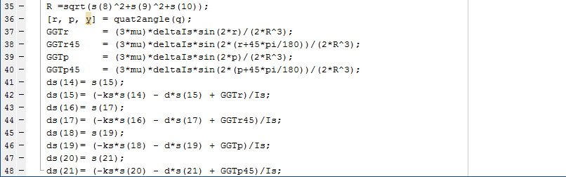
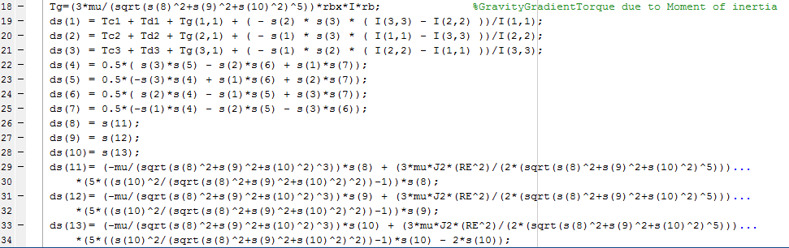
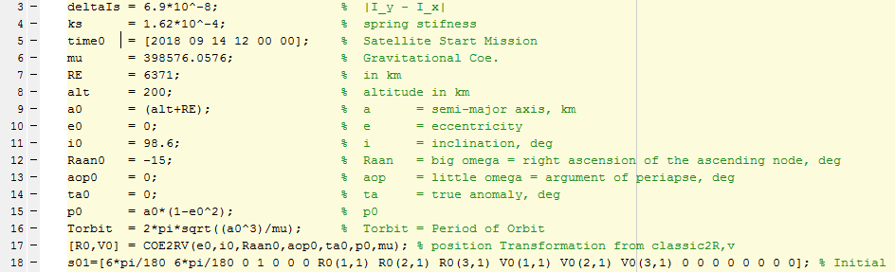
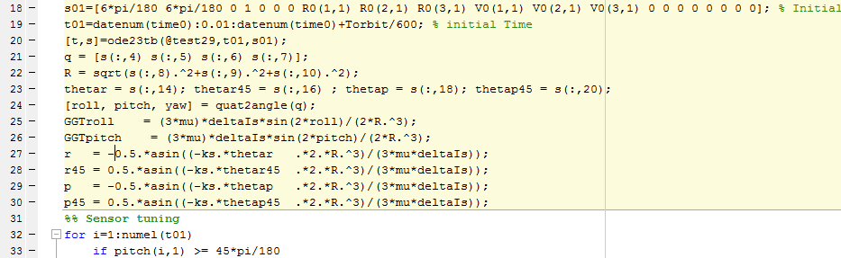
Simulation

Slide 10
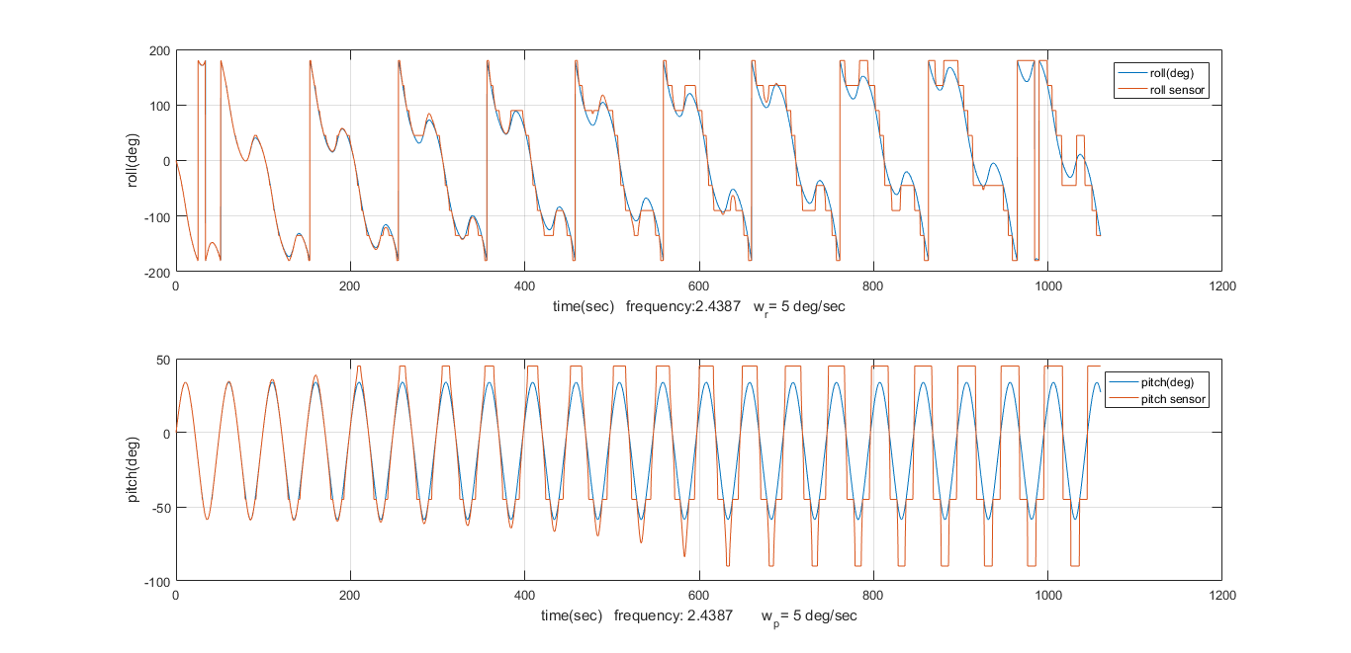
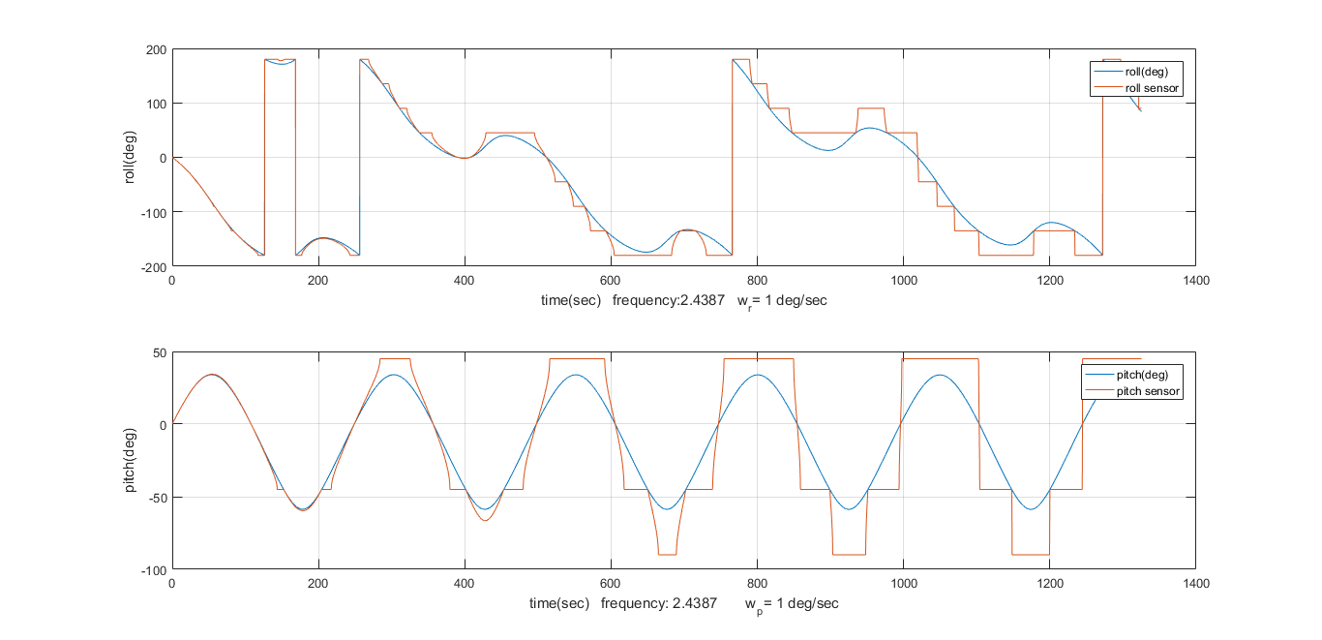
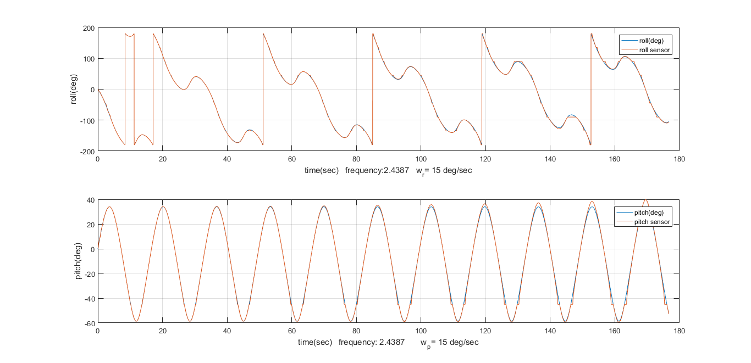
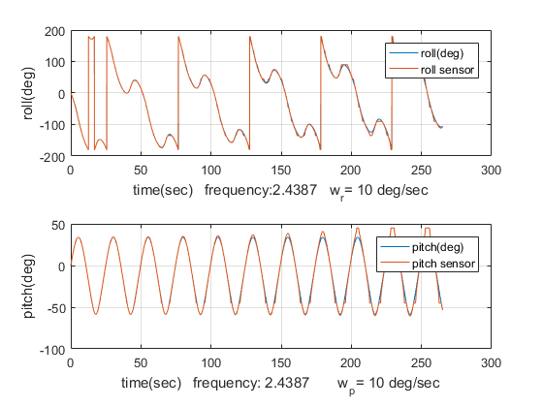
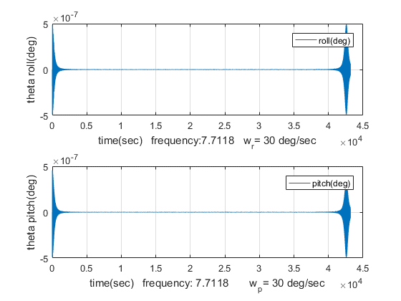
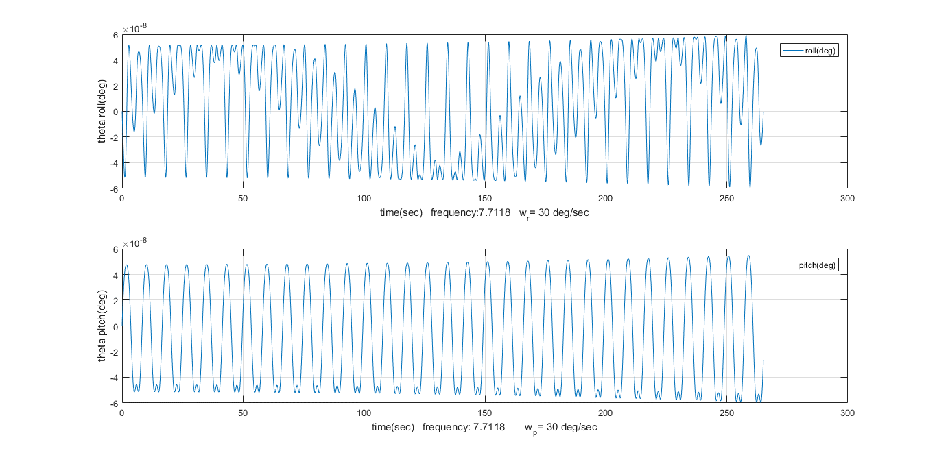
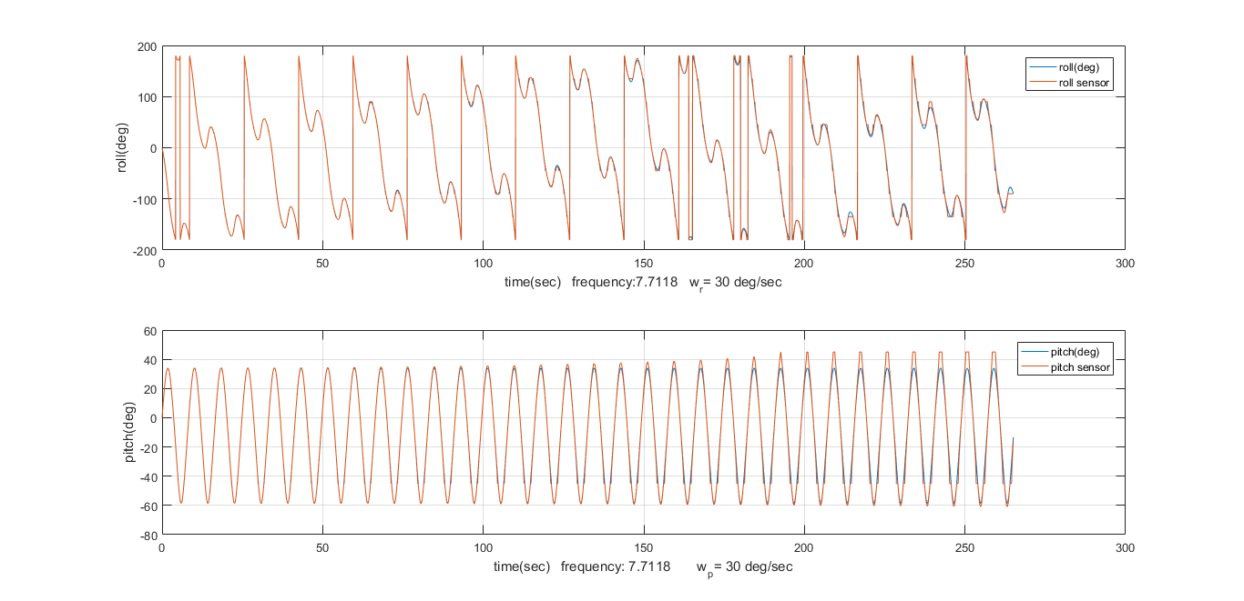
Conclusion

